Slide 1
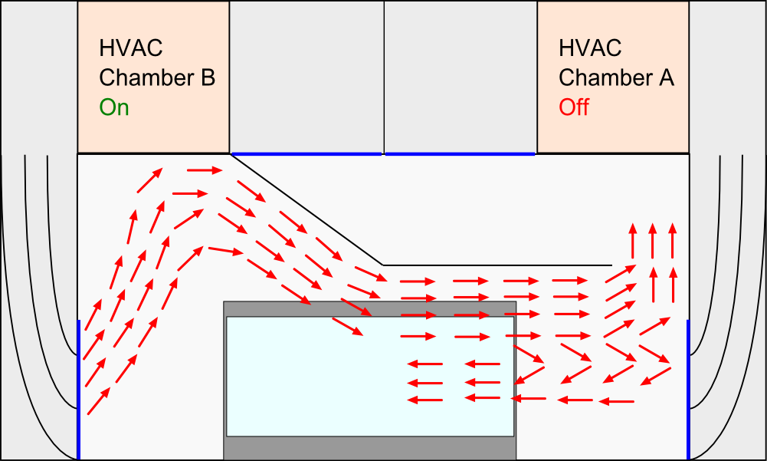
Air flow (Tests 0-37 & 45-47)

Slide 2
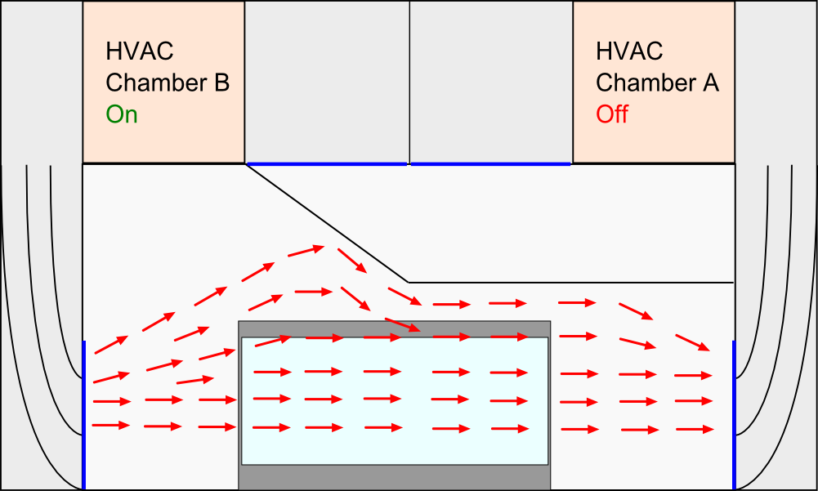
Air flow (Tests 38-44 → 5 fans – 10pct )

Slide 3
Test 40
T_cond: 35°C
T_defr: 4h
Fan Settings: 5 fans 10pct
(closed ceiling)

Slide 4
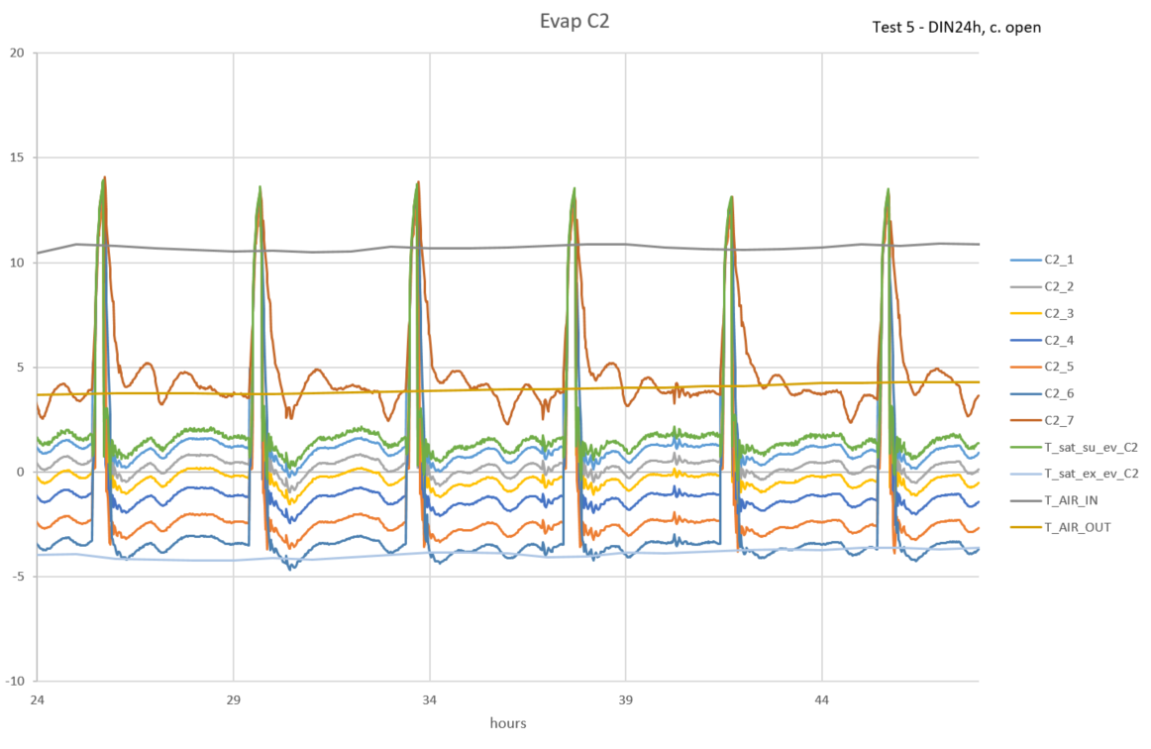
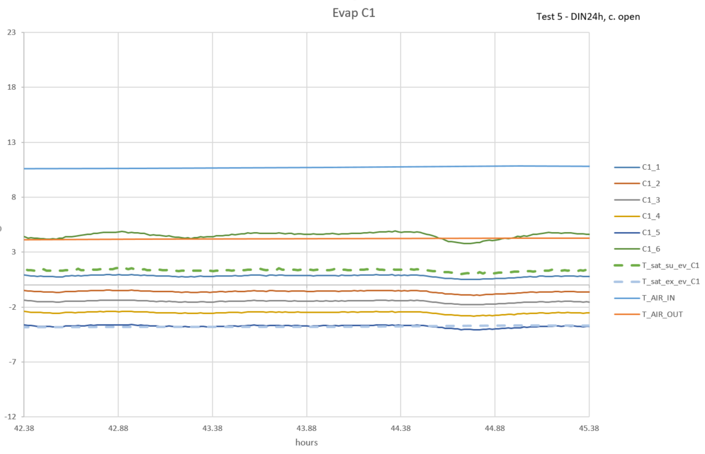
Previous testing (Test 40)
after changing back to HATCOL
Evaporating temperature looked like this:

Slide 5
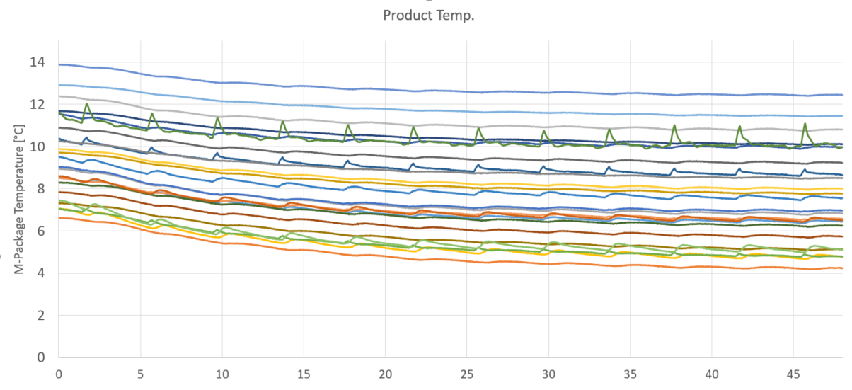
Product temperature:

Slide 6
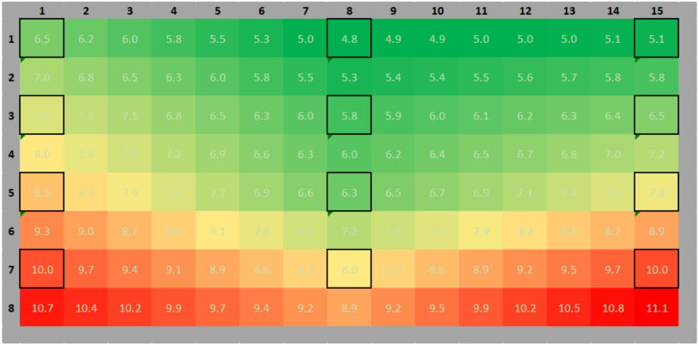
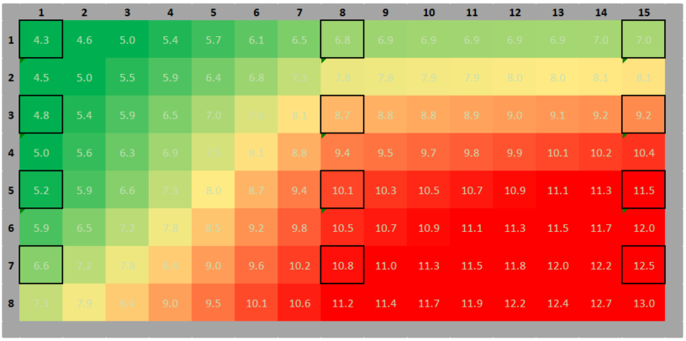
Front:
Back:

Slide 7
Possible Reasons
Too much oil in the system? (Oil stuck in condenser? Mixture HATCOL-3MAF?)
Lower air velocity → Chamber regulation is worse
higher temperature gradient in height
higher humidity oscillating → more dehumidifying?
More air streaming in front of the cabinet →more warm air is sucked in by the air curtain?

Slide 8
Test 47
T_cond: 35°C
T_defr: 4h
Fan Settings: 2 fans 25pct
(ceiling opened again)

Slide 9
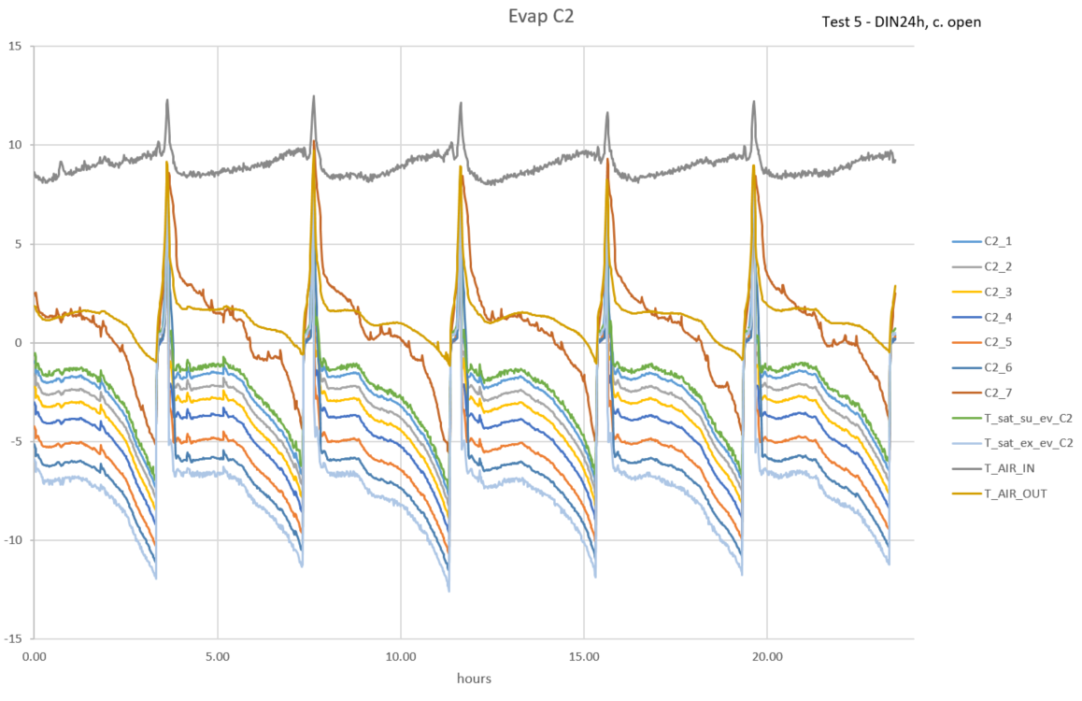
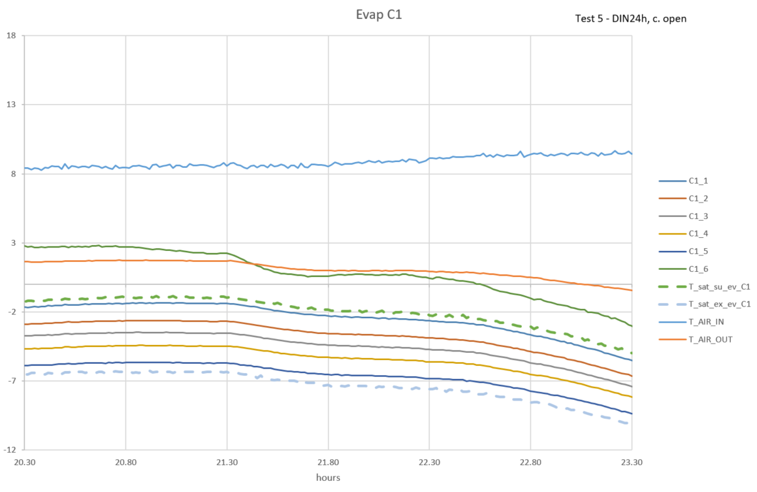
Latest Test (Test 47)
Evaporating temperature:

Slide 10
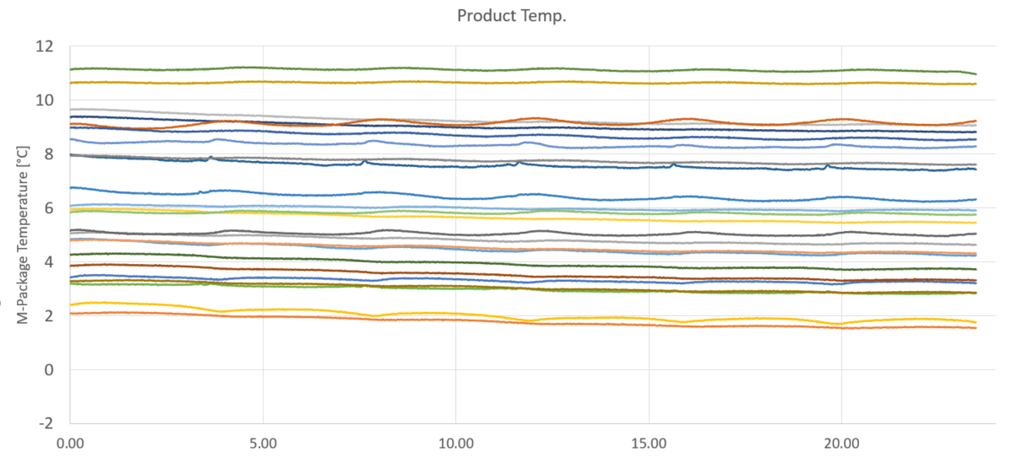
Product temperature:

Slide 11
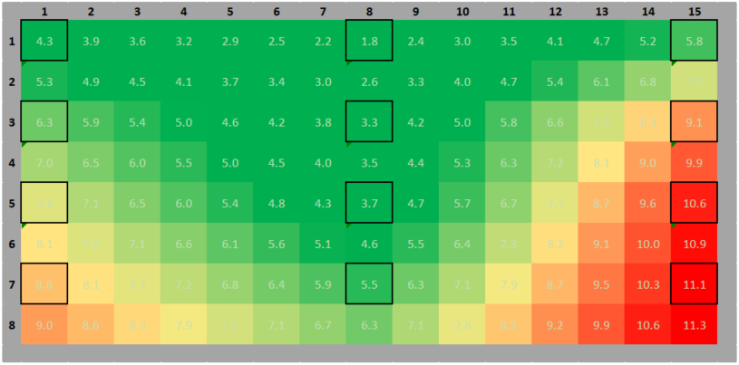
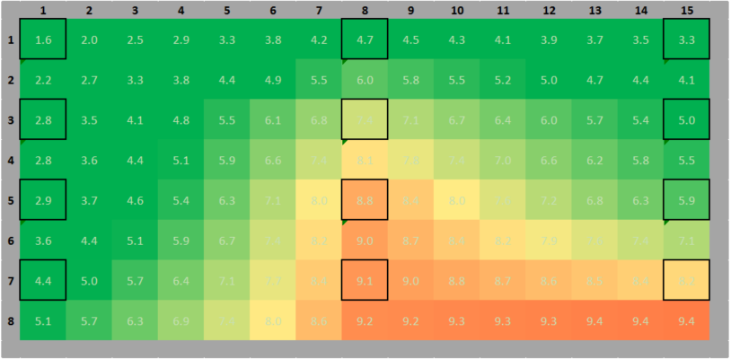
Front:
Back:

Slide 12
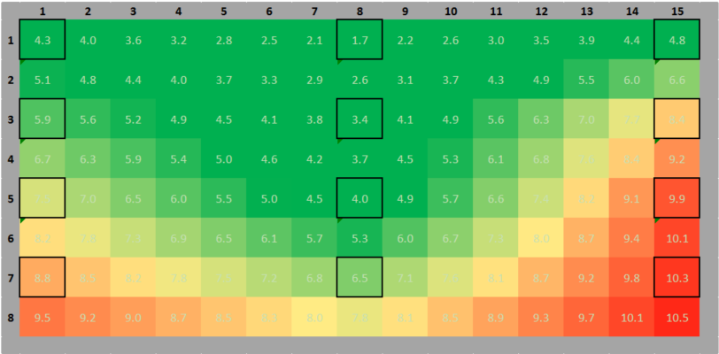
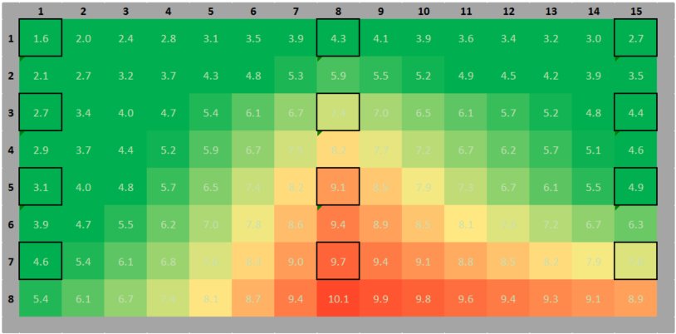
Comparison: Test 47 – Test 24
Almost good! Next results on Tuesday!

